Slide 1
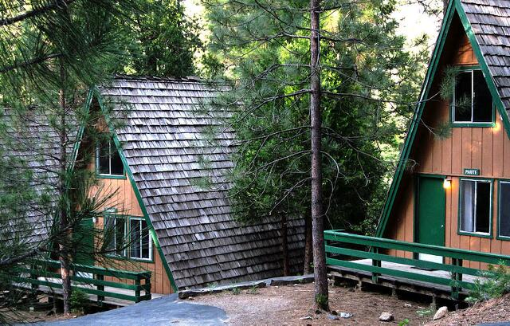
Camp Wawona

Slide 2
